Slide 1
How Do Clouds Form?
In order to understand this process, we must first understand cold/warm air, and their relationship with density.
What is density???
Notes:
Density represents how molecules behave with one another in a substance or object. If the molecules move slowly, they will become tightly packed, resulting in a higher density. If the molecules move very fast, they will become more and more spaced apart from each other, resulting in a lower density.
Water and air behave very similarly…thus water can be used as a great example of how air parcels, or bubbles of air, can move when heated or cooled. When the air/water is heated, tiny bubbles will form and rise, because they have a lower density that the surrounding air/water. This can be viewed best when performing a “density” experiment.

Slide 2
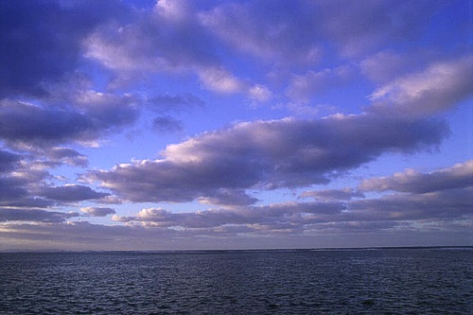
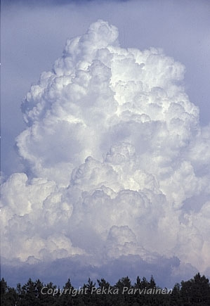
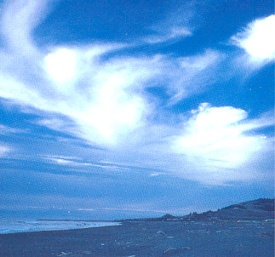
Cloud Formation
Notes:
In order for clouds to form, a lifting mechanism, moisture (water droplets), and condensation nuclei are needed. The density experiment proved that indeed, warm air/water is less dense than cold air/water. Warm air can also serve as a good lifting mechanism needed to produce clouds. As the warm air rises, the air temperature will cool to the dewpoint temperature, the temperature that is needed to reach saturation.
Water droplets form, and will bond onto the condensation nuclei, which will allow other water droplets/condensation nuclei to collide and coalesce. These aerosols consist of suspended solid (dust, smoke, etc) and liquid particles, and provides a surface for the water vapor droplets to adhere to. This collision and coalescence process will make the droplet larger and will eventually form a cloud.
Warm air acts as a good lifting mechanism to aid in the collision/coalescence process, where the condensation nuclei collide with other nuclei, causing the water droplets to grow larger and larger.

Slide 3
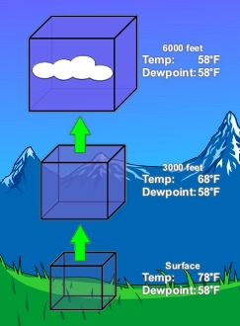
Cloud Formation (Cont’d)
Warm air rises (less dense), and will gradually cool. The air will begin condensing (when the temperature and dewpoint become closer together), and water droplets bond onto condensation nuclei. These nuclei will collide with other nuclei, eventually forming a cloud.
Notes:
Air can reach saturation in a number of ways. The most common way is through lifting. As a bubble or parcel of air rises it moves into an area of lower pressure (pressure decreases with height). As this occurs the parcel expands. This requires energy, or work, which takes heat away from the parcel. So as air rises it cools. This is called an adiabatic process. Since cold air can hold less water vapor than warm air, some of the vapor will condense onto tiny clay and salt particles called condensation nuclei. The reverse is also true. As a parcel of air sinks it encounters increasing pressure so it is squeezed inward. This adds heat to the parcel so it warms as it sinks. Warm air can hold more water vapor than cold air, so clouds tend to evaporate as air sinks.

Slide 4
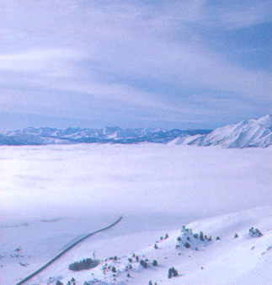
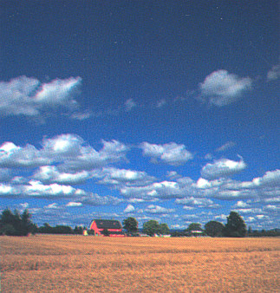
Types of Clouds
Low clouds: Consist of stratoform (flat) clouds, or cumuloform (puffy) clouds, lying on or just above the surface (up to ~10,000 ft).
Stratus: Cumulus:
Notes:
Stratus clouds consist of a feature-less low layer that can cover the entire sky like a blanket, bringing generally gray and dull weather. The cloud bases are usually only a few hundred feet above the ground. Over hills and mountains they can reach ground level when they may be called fog. Also, as fog "lifts" off the ground due to daytime heating, the fog forms a layer of low stratus clouds.
Cumulus clouds are of small vertical development with flat bases and rounded tops. These types of clouds indicate fair weather.

Slide 5
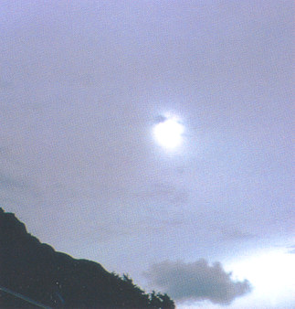
Types of Clouds (Cont’d)
Middle Clouds: Consist of altoform (meaning a middle cloud) type clouds, extending from 10,000 – 20,000 feet above the surface.
Altostratus: Altocumulus:
Notes:
These clouds typically form between 7,000 and 15,000 feet (2,100 to 4,600 m) and bring steady precipitation. As the clouds thicken and precipitation begins to fall, the bases of the clouds tend to lower toward the ground.

Slide 6
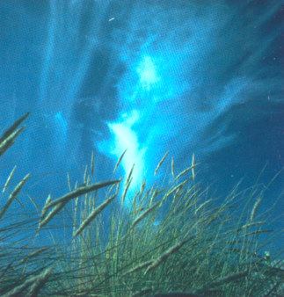
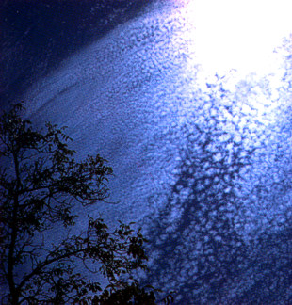
Types of Clouds (Cont’d)
High Clouds: Consists of mainly ice crystals suspended above 20,000 feet from the surface. These clouds are wispy/crisp/featherlike in appearance, and do not produce precipitation.
Cirrus: Cirrostratus: Cirrocumulus:
Notes:
High-level clouds which form above 20,000 feet and are usually composed of ice crystals. High-level clouds are typically thin and white in appearance, but can create an array of colors when the sun is low on the horizon. Cirrus generally occur in fair weather and point in the direction of air movement at their elevation.

Slide 7
How Does Rain Form???
Through the collision/coalescence process, water droplets continue to grow, forming clouds. If enough lift is present in the atmosphere (produced by fronts for example), updrafts are created, which forces the cloud to grow taller. The water droplets continue to grow inside of clouds, until they become too heavy to be suspended by the updraft. It is then that these droplets fall down to the earth as rain.

Slide 8
How can clouds help find patterns in weather changes???
Movement of weather (Fronts & Air Masses)
Change in air pressure.
Future precipitation
Drizzle to Heavy Rain
Gives us an idea of possible weather conditions for next 12 to 24 hours.

Slide 9
Quick Reference – Cloud Identification
Cirro – High Clouds
Alto – Medium Clouds
Stratus – flat clouds the cover the sky
Cumulus – puffy clouds (cotton balls)
Nimbus – brings precipitation

Slide 10
High Clouds - Cirrus
A large number advance of front or storm system
Form above 18,000 feet.
Three types
Cirrus
Cirrostratus
Cirrocumulus

Slide 11
Cirrus
Form at the edges of air masses/fronts.
Pleasant weather for at least 24 hours.
Occur in high pressure but air pressure will change.
Weather may change in 24 to 36 hours.

Slide 12
Cirrostratus
Sometimes signal the approach of a warm front .
Signs that precipitation might follow in the next 12 to 24 hours^{[3]} or as soon as 6–8 hours if the front is fast moving. Signal moisture in atmosphere.

Slide 13
Cirrocumulus
Usually means rain in 8–10 hours (can be more if front is slow moving). If only small patches of cirrocumulus and perhaps some wisps of cirrus, it usually good weather.
If it is seen after rain it usually means improving weather.

Slide 14
Medium Clouds - Alto
Assist in predicting weather changes in 6 to 12 hours
Medium high clouds occupy altitudes of 6,500 feet to 18,000 feet
One type
Altocumulus

Slide 15
Altocumulus
Altocumulus is also commonly found between the warm and cold fronts in a depression, although this is often hidden by lower clouds.
Frequently signals the development of thunderstorms later in the day, as it shows instability.

Slide 16
Low Clouds - Stratus
Low clouds, called stratus clouds, are at altitudes up to 6,500 feet.
These Clouds form a solid sheet or layer of cloud mass.
Three types
Cumulus
Stratocumulus
Cumulonimbus
Nimbostratus

Slide 17
Cumulus
Usually indicate fair weather..
Except if they have some vertical development which occur in front of a cold front.

Slide 18
Cumulonimbus
Cumulonimbus storm cells can produce torrential rain and flash flooding, as well as strong winds.
They cause thunderstorms .
Cumulonimbus clouds can also bring dangerous winter storms (called "blizzards") which bring lightning, thunder, and torrential snow. However, cumulonimbus clouds are most common in tropical regions.

Slide 19
Stratocumulus
Most produce no precipitation, and when they do, it is generally only light rain or snow.
Often seen at either the front or tail end of worse weather, so they may indicate storms to come, in the form of thunderheads or gusty winds.
Often precede a warm front.

Slide 20
Nimbostratus
A sign of easily steady to powerful precipitation, as opposed to the shorter period of typically heavier precipitation released by a cumulonimbus cloud.
Precipitation may last for several days, depending on the speed of the warm or occluded front it accompanies clouds.

