Slide 1
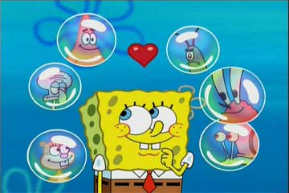
Lab Safety Rules
With help from Sponge Bob and the Bikini Bottom Gang

Slide 2
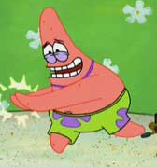


Conduct yourself in a responsible manner at all times in the laboratory. This is not the playground.
Never run, horseplay, play practical jokes or push someone else in the lab. This rule applies at all times.

Slide 3

What’s the safety rule?
Never run
or horseplay in the lab.

Slide 4


Follow all written and verbal instructions carefully.
It’s a good idea to “check off” each step of a procedure as you conduct it.
LISTEN to your teacher carefully.

Slide 5
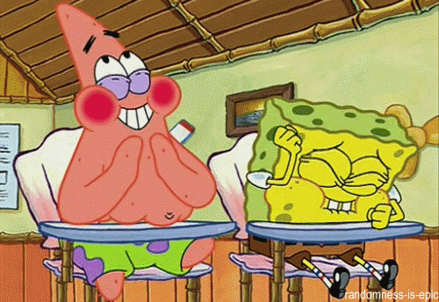


When you don’t understand directions, ask the teacher for help.
?

Slide 6

Keep your notes with you when doing tests or experiments. They were created to help you.

Slide 7

Directions
Clear the desk of anything unnecessary, and
Read the board for directions.

Slide 8
Do not touch anything until you are given directions to do so.

Slide 9
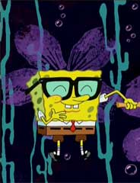
Always wear safety goggles
whenever you are working
with chemicals or other
substances that might get
into your eyes.

Slide 10


Lab coats are optional but recommended this year.

Slide 11

Dress properly during a laboratory activity.
Roll up loose sleeves.
Always tie back long hair before working with lab equipment.

Slide 12
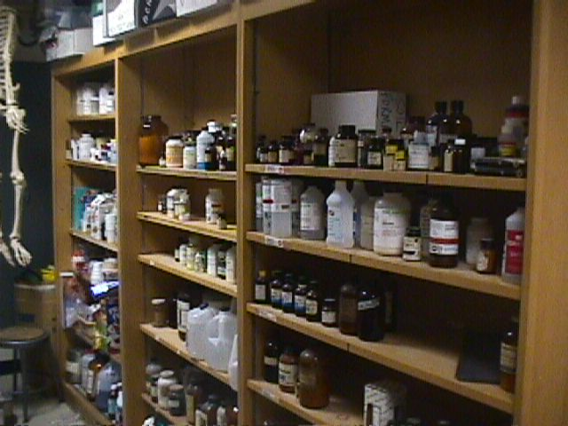
Students are never permitted in the science storage closets unless given specific permission by the teacher.
Storeroom

Slide 13


All chemicals in the laboratory are to be considered dangerous. Do not touch, taste or smell any chemicals unless specifically instructed to do so.

Slide 14

Always clean up your work area and equipment after an experiment is completed. Equipment must be returned to its proper place.

Slide 15

Always notify your teacher if a spill happens IMMEDIATELY, whether they are on the lab table or floor. Spills can cause dangerous accidents.

Slide 16
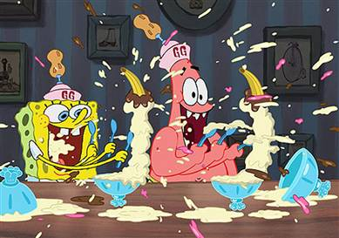
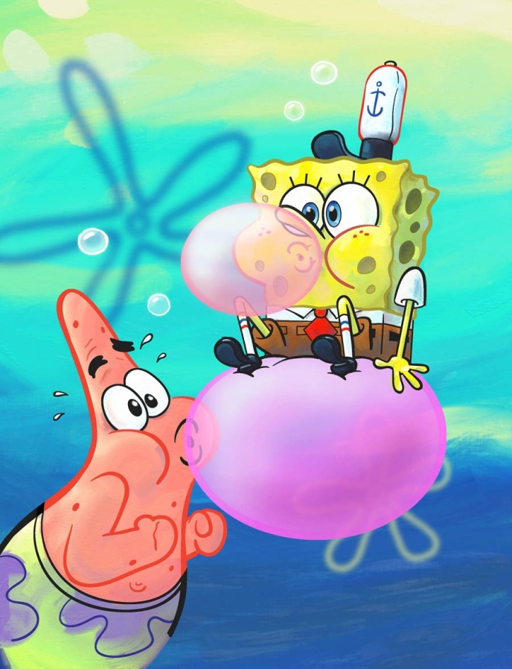
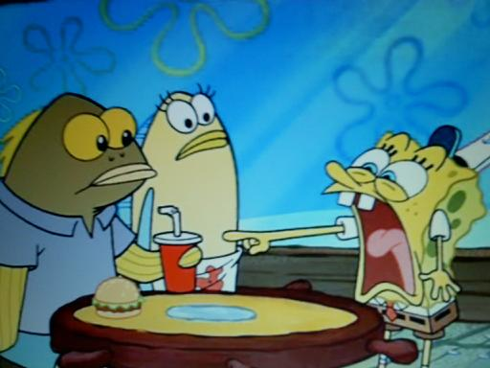
Do not eat food, drink beverages or chew gum in the laboratory.

Slide 17
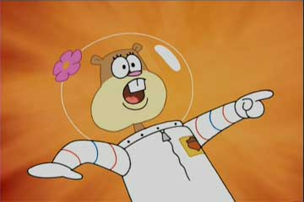
Notify your teacher if any chemical gets on your skin or clothing to find out what to do to clean it off.

Slide 18

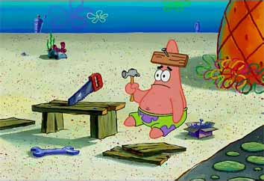

Immediately notify your teacher if you get cut or have another injury when performing an experiment.

Slide 19


Never perform any tests without your teacher’s permission.

Slide 20

Keep lids on bottles and containers when not in use.

Slide 21
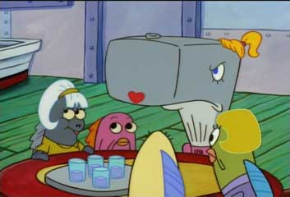
Never use broken, dirty or chipped glassware. Report damages to teacher immediately.

Slide 22

What’s the safety rule?
Always sweep up glass; NEVER pick it up with your hands.

Slide 23



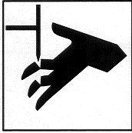
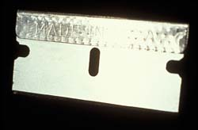
Sharp Objects
Always cut away from fingers and body
Always carry sharp objects
with points and tips facing
down and away
Never try to catch falling
sharp instruments
Grasp sharp instruments
only by the
handles
Notes:
http://images.google.com/imgres?imgurl=http://68.90.81.6/ScienceTAKS/Integration/Science%2520TAKS%2520Objective%25201/safety4.jpg&imgrefurl=http://68.90.81.6/ScienceTAKS/Integration/Science%2520TAKS%2520Objective%25201/safetysymbols.htm&h=95&w=93&sz=3&hl=en&start=32&um=1&tbnid=AOIrcMWCY6-NPM:&tbnh=80&tbnw=78&prev=/images%3Fq%3DLab%2BSafety%2BSymbols%26start%3D20%26ndsp%3D20%26svnum%3D10%26um%3D1%26hl%3Den%26rls%3DGGLB,GGLB:1969-53,GGLB:en%26sa%3DN

Slide 24

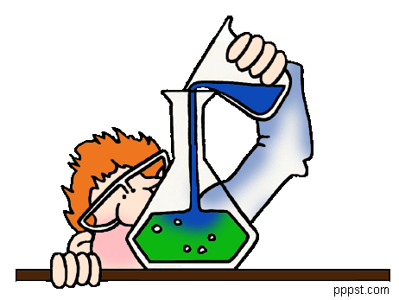
Handle all equipment carefully, it is used by every student.

Slide 25


Congratulations! You are almost ready!

