Slide 1
Moon Phases

Slide 2
Half of the Moon is always lit up by the sun. As the Moon orbits the Earth, we see different parts of the lighted area.
http://www.nasm.si.edu/apollo30th/moontheater/phasepage2.html

Slide 3
The movement of the Moon around the Earth makes the Moon look as if it is changing shape in the sky.
http://btc.montana.edu/ceres/html/birthdayphases.htm
Notes:
3

Slide 4
This is caused by the different angles from which we see the lighted part of the Moon's surface. These are called "phases" of the Moon.
http://btc.montana.edu/ceres/html/birthdayphases.htm

Slide 5
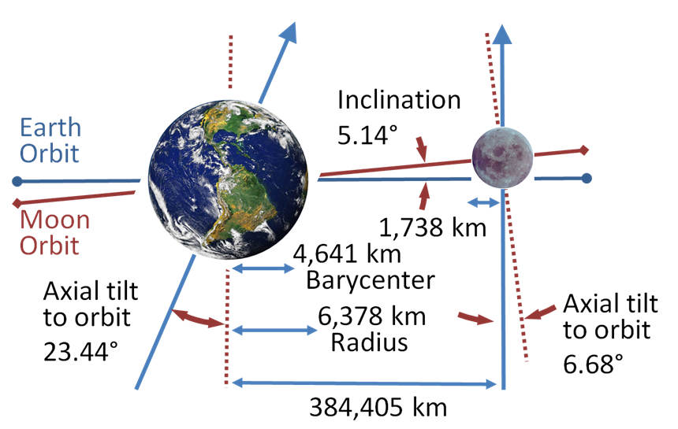
More information about Moon Movement
The moon does not move exactly around the Earth’s equator. It moves either above or below the Earth’s center.

Slide 6
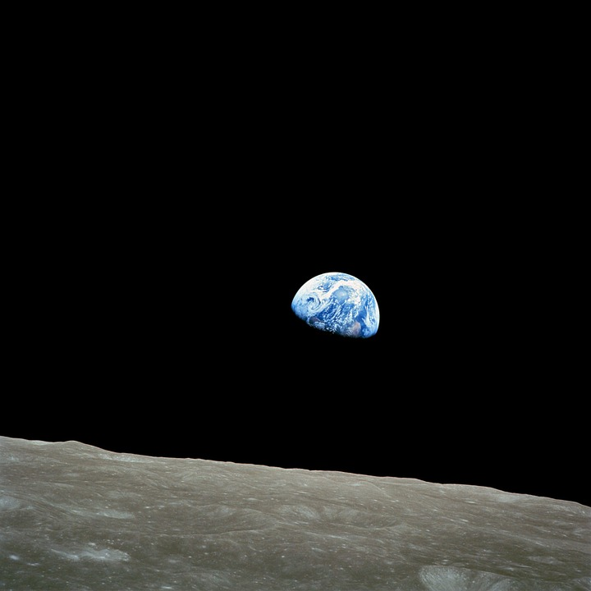
Is there really a dark side of the moon?
Due to gravity, the moon moves around the Earth with the same 50% of it always facing Earth. We never see the other side of the moon, but is it always dark?

Slide 7
http://www.niehs.nih.gov/kids/lunar/why_phases.gif
Notes:
7

Slide 8
The Moon passes through four major shapes during a cycle that repeats itself every 29.5 days. The phases always follow one another in the same order:
New moon
First quarter
Third or Last quarter
Full moon
Notes:
8

Slide 9
New Moon
The lighted side of the Moon faces away from the Earth. This means that the Sun, Earth, and Moon are almost in a straight line, with the Moon in between the Sun and the Earth. The Moon that we see looks very dark.

Slide 10
New Moon
Notes:
10

Slide 11
First Quarter Moon
The right half of the Moon appears lighted and the left side of the Moon appears dark. During the time between the New Moon and the First Quarter Moon, the part of the Moon that appears lighted gets larger and larger every day, and will continue to grow until the Full Moon.
Notes:
11

Slide 12
First Quarter Moon
Notes:
12

Slide 13
Third (Last) Quarter Moon
Sometimes called Third Quarter. The left half of the Moon appears lighted, and the right side of the Moon appears dark. During the time between the Full Moon and the Last Quarter Moon, the part of the Moon that appears lighted gets smaller and smaller every day. It will continue to shrink until the New Moon, when the cycle starts all over again.

Slide 14
Third or Last Quarter Moon

Slide 15
Full Moon
The lighted side of the Moon faces the Earth. This means that the Earth, Sun, and Moon are nearly in a straight line, with the Earth in the middle. The Moon that we see is very bright from the sunlight reflecting off it.

Slide 16
Full Moon

Slide 17
There are also four other phases of the Moon sometimes used.

Slide 18
Waxing Crescent Moon
This Moon can be seen after the New Moon, but before the First Quarter Moon. The crescent will grow larger and larger every day, until the Moon looks like the First Quarter Moon.
("Waxing" means increasing, or growing larger.)
http://btc.montana.edu/ceres/html/birthdayphases.html
Notes:
18

Slide 19
Waxing Crescent Moon
http://btc.montana.edu/ceres/html/birthdayphases.html
Notes:
19

Slide 20
Waxing Gibbous Moon
This Moon can be seen after the First Quarter Moon, but before the Full Moon. The amount of the Moon that we can see will grow larger and larger every day. ("Waxing" means increasing, or growing larger.)
http://btc.montana.edu/ceres/html/birthdayphases.html

Slide 21
Waxing Gibbous Moon
http://btc.montana.edu/ceres/html/birthdayphases.html
Notes:
21

Slide 22
Waning Gibbous Moon
This Moon can be seen after the Full Moon, but before the Last Quarter Moon. The amount of the Moon that we can see will grow smaller and smaller every day. ("Waning" means decreasing, or growing smaller.)
http://btc.montana.edu/ceres/html/birthdayphases.html

Slide 23
Waning Gibbous Moon
http://btc.montana.edu/ceres/html/birthdayphases.html
Notes:
23

Slide 24
Waning Crescent Moon
This Moon can be seen after the Last Quarter Moon and before the New Moon. The crescent will grow smaller and smaller every day, until the Moon looks like the New Moon.
("Waning" means decreasing, or growing smaller.)
http://btc.montana.edu/ceres/html/birthdayphases.html
Notes:
24

Slide 25
Waning Crescent Moon
http://btc.montana.edu/ceres/html/birthdayphases.html

Slide 26
http://www.opencourse.info/astronomy/introduction/04.motion_moon/moon_phases.gif
Notes:
26

Slide 27
Waxing & Waning
http://www.nasm.si.edu/apollo30th/moontheater/phasepage4.html
Notes:
27

Slide 28
http://www.nasm.si.edu/apollo30th/moontheater/phasepage4.html
Notes:
28

Slide 29
http://www.calvin.edu/~lmolnar/moon/images/phases.gif
Notes:
29

Slide 30
Moon Movie
The movie is an animated GIF created by Antonio Cidadao from a sequence of still images taken during March and April 1998.
Copyright Antonio Cidadao.
http://aa.usno.navy.mil/faq/docs/moon_phases.html
Notes:
30

Slide 31
MOON QUIZ!!
http://starchild.gsfc.nasa.gov/docs/StarChild/solar_system_level2/moonlight.html
Notes:
31

