Slide 1
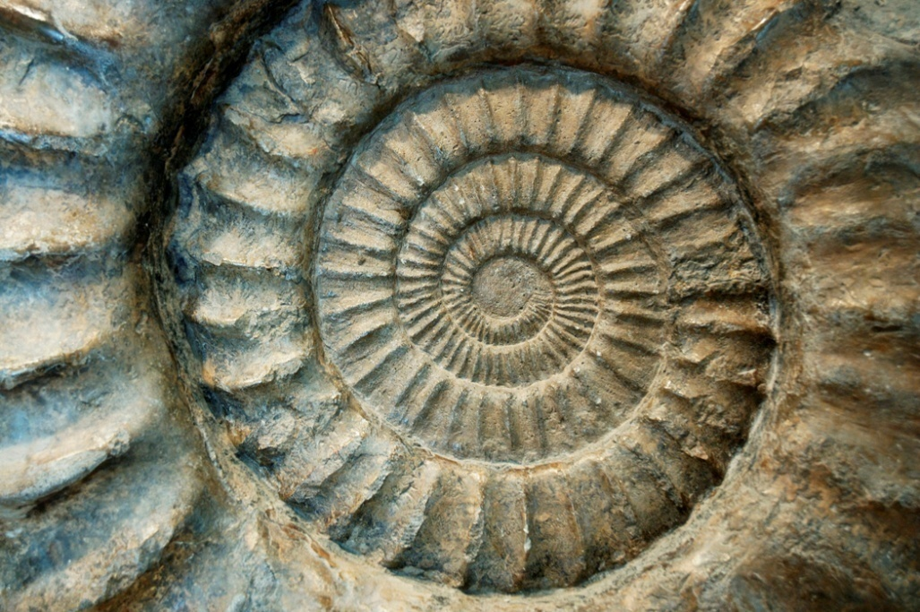
Fossils and The Law of Superposition
Resource: Liz LaRosa Science http://www.middleschoolscience.com 2009
This powerpoint was created with the information from the FOSREC Activity “Who’s on First?” and “Fossil Inferences” by UEN.

Slide 2
Fossils and Superposition
What is a fossil?
The trace or remains of an organism that lived long ago, most commonly preserved in sedimentary rock
What is the law of superposition?
Younger rocks lie above older rocks if the layers have not been disturbed.

Slide 3
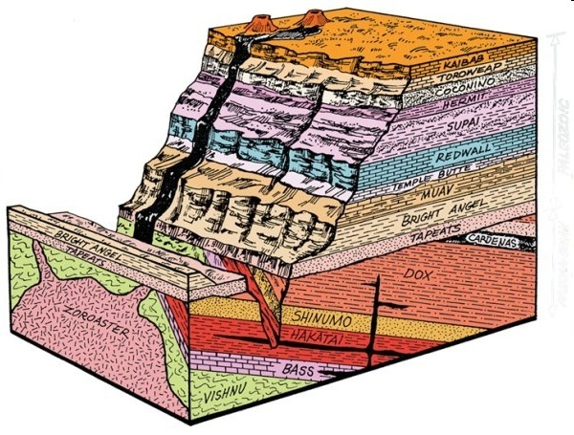
What is Relative Dating?
Any method of determining whether an event or object is older or younger than other events or objects
For example, each of these Grand Canyon rock layers represents a period of time in Earth's history.
Are the youngest layers on the top or the bottom? How can you tell?

Slide 4
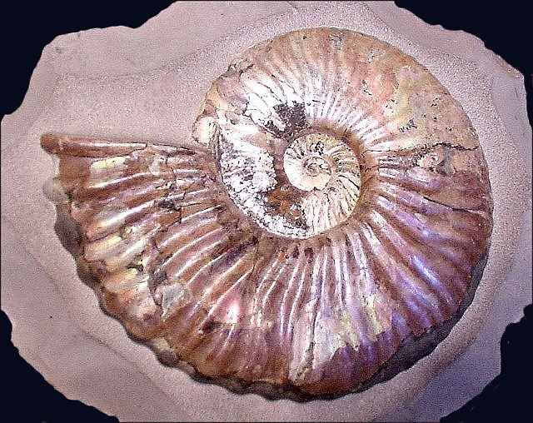
Index Fossils
What is an index fossil?
A fossil that is found in the rock layers of only one geologic age and is used to establish the age of the rock layers.
Found in rock layers
around the world.
Example: Ammonite

Slide 5
Activity # 1
On your table you have 8 index cards with nonsense letters placed on them.
Your task is to determine what the correct sequence of the letters are.
You have two clues:
The card with the letters “C” and “T” is the bottom, oldest layer
Look for a card that has either a “T” or “C” written on it for the second layer.
Continue until all cards are placed in a logical sequence.

Slide 6
M
D
X
O
N
B
U
A
G
C
T
Questions:
What letter is the oldest?
What letter is the youngest?
What letter showed up the most?
Which letters only showed up once?
Which letters could be index fossils?
How did you know which was older: “M” or “X”?
MD
DXO
ON
NB
NBU
UA
AGC
C T

Slide 7
Activity # 2: Fossil Cards
Arrange the index cards that represent layers of rock and fossils.
Clues:
The oldest layer has the letter “M” in it
Find a rock layer that has at least one of the fossils you found in the oldest rock layer. Place it above the oldest layer. Continue until you have placed all cards.
Extinction is forever - once an organism disappears from the sequence it cannot reappear later.

Slide 8
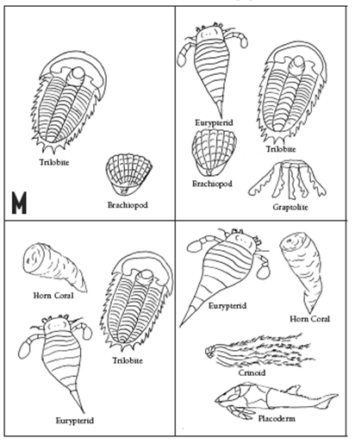
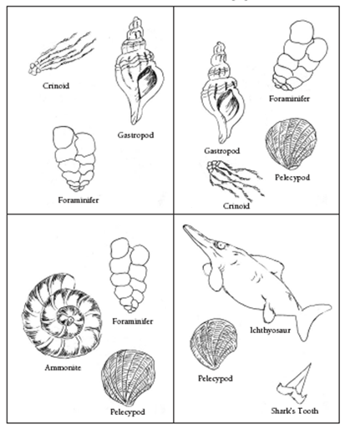

Slide 9
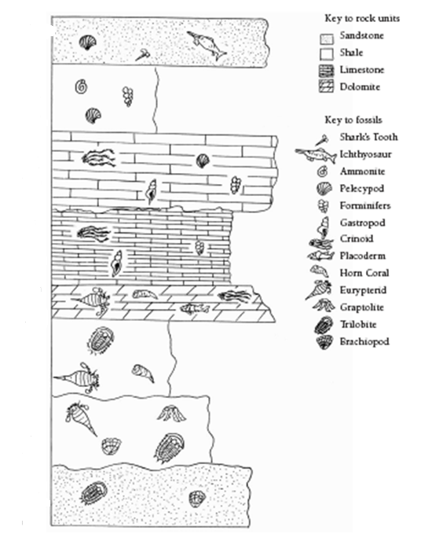
A
N
S
WE
R

Slide 10
To think about…
What problems did you run into when trying to arrange the fossils into the correct sequence?
Would this have been more difficult if you did not know which layer was the oldest to start the activity?

